Slide 1
Ashutosh J.
Lead Vocalist & Guitarist
IT Support Specialist
Disease Prediction and Curability.
Getting medical service, quality to doorstep

Slide 2
The Trinity
Somya Ranjan Patra
(National Institute Of Technology,Rourkela,2018-2022)
Debabrata Panda
(National Institute Of Technology,Rourkela,2018-2022)
Asish Kumar Nayak
(National Institute Of Technology,Rourkela,2018-2022)

Slide 3

Objective
To get the healthcare service to the people's doorstep and get it aligned with the quality of cost affordability factor.
What could be the thought behind it?
In today's world, there are many people who just can't go and show up their condition to a doctor due to various reasons like lack of money or hesitation to go out in this pandemic situation and many more.
So, we'll create that interface which will help out the scenario.
Afterall, everyone deserves quality service!

Slide 4

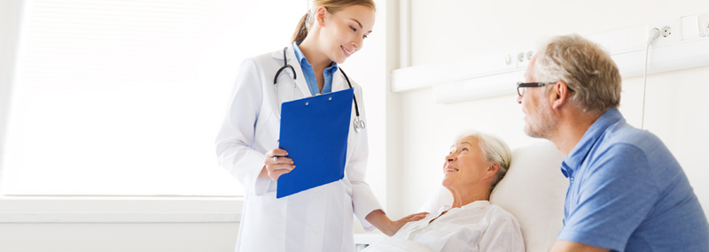
Solution
We have an application which clarifies user on disease symptoms, cure and treatment. The main feature is the detection of skin diseases by use of deep learning methods in the app itself. We can tell about the percentage of infection, its probability and cost effective remedies.
It will help the senior citizens who cant always go out which also helps for the current covid situation.
Technicalities
TensorFlow api, Pytorch, Visual Studio,Python,C++

Slide 5
IMPACT
People will get quality service at an affordable price.
Considering the pandemic situation, as physical interaction is quite out of the scene so people can get the same facilities right from home. Similarly old age grouped population can also get these service which will help them to get their required healthcare service without involving any travelling.
We together can get along with the actual requirement behind this whole idea and accordingly could affect the lives of people which has been the prime concern considering the company's integrity for such a long time!

